Slide 1
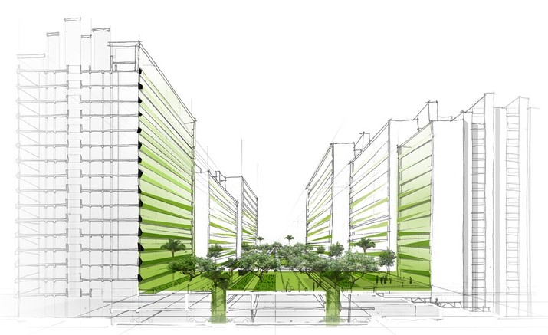
HDB Resale Flat
Written By Tan Wen Hua (Roy)
StudentID: P7338001

Slide 2
Objectives of this project
HDB Agent able to use these materials to accomplish his/her task to assist his clients
Assist Buyers or Sellers of Resale Flat in decision making by providing adequate information
Flexibility in providing user's preferences of their desired flat requirements
Ability to process it when data changes in the dataset such as time line increased.

Slide 3
Is it time to Buy / Sell Flat ?
Some of the questions the HDB buyer/seller may ask:
What is the current trend of HDB resale flat price ?
Will the HDB resale flat price cooling measures affect me ?
Will there be a different HDB Median Price between each town?
Is the HDB Prices deviation for each town the same ?
What is the volume for different flat type ?
What is the HDB price range for each town based on my preferences such as flat type, period selected, remaining number of lease year ?
If I found a desired flat I like to purchase, what is the HDB price range I should offer ?
What is suitable price I should sell my flat ?
What is the proportion of ethnic group in HDB Flat ?

Slide 4
Resolution to these question
HDB already provided some dataset which could help us in answering those question.
However, we need tools help us organise these dataset information into useful information that could resolve these issue.
These useful information could be in the form of text-based analysis or the graphical data visualization.

Slide 5
List of URLs of datasets used for this project
HDB Resale Price Index
https://data.gov.sg/dataset/hdb-resale-price-index
Used in ResalePriceIndex.py
Median Resale Prices for Registered Applications by Town and Flat Type
https://data.gov.sg/dataset/median-resale-prices-for-registered-applications-by-town-and-flat-type
Used in CoolingMeasure.py, LineChartByTown.py
Number of Resale Applications Registered by Flat Type, Quarterly
https://data.gov.sg/dataset/number-of-resale-applications-registered-by-flat-type-quarterly
Used in ResaleApplication.py
Resale Flat Prices
https://data.gov.sg/dataset/resale-flat-prices
Used in ResaleFlat.py, SpecificFlat.py
Resident Households by Type of Dwelling, Ethnic Group of Head of Household and Tenancy, 2015
https://data.gov.sg/dataset/resident-households-by-type-of-dwelling-ethnic-group-of-head-of-household-and-tenancy-2015
Used in HDBdwelling.py
Python Program generating the dataset description: DataSetDescription.ipynb

Slide 6
HDB Resale Price Index Dataset
Help us understand the current HDB resale price trends.
Tracks the overall price movement of the public residential market.
The index is based on quarterly average resale price by date of registration. The index till 3Q2014 was computed using stratification method, while that from 4Q2014 onwards is computed using the stratified hedonic regression method. 1Q2009 is adopted as the new base period with index at 100.
Python Program using this dataset: ResalePriceIndex.py

Slide 7
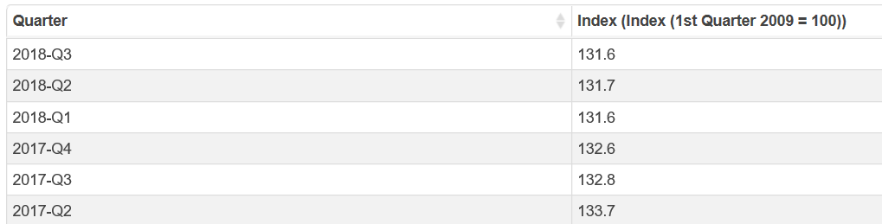
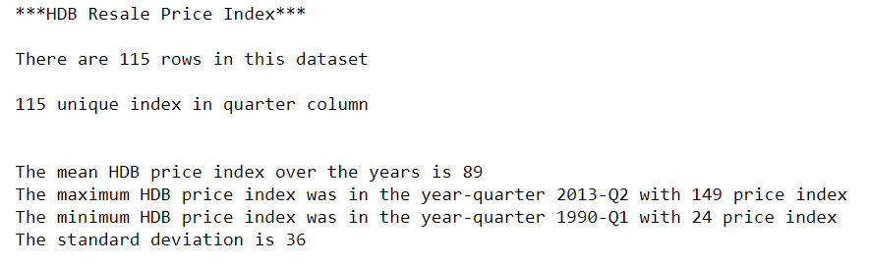
HDB Resale Price Index Dataset

Slide 8
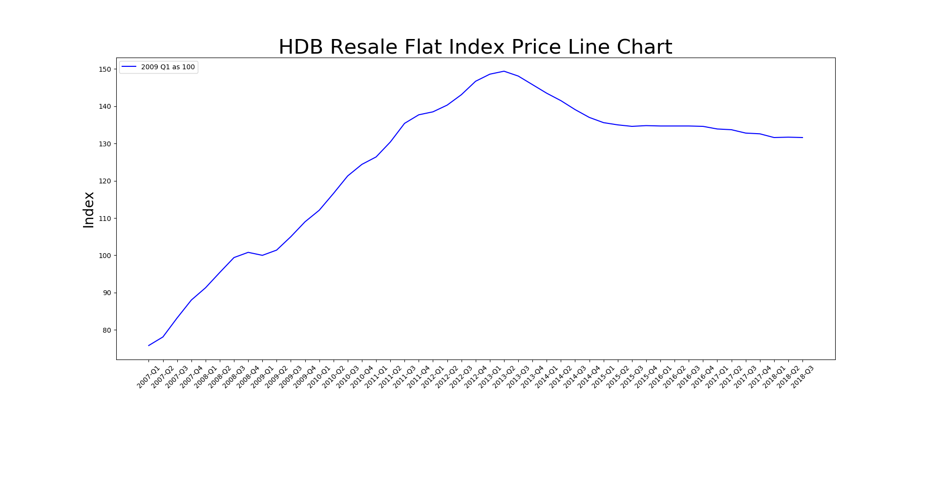
HDB Resale Price Index
We could use the line chart to help understand the HDB resale price trends.
The HDB resale index price rose until year 2013 Q2 and decline after that and gradually stable at year 2015 with weak deviation lower at the end.
The cause of it’s decline in due to the HDB cooling measures taken place and more new HDB flat supply.

Slide 9
HDB Cooling Measures
Does the HDB Cooling Measures affect the HDB Resales Price ?
How effective is the HDB Cooling Measures ?
In order to understand the HDB Cooling Measures affecting the HDB Resales Price, we could use the following dataset:
Median Resale Prices for Registered Applications Dataset
And the HDB Cooling Measures Timeline. The information could be obtain from the HDB web site or the SRX web site.

Slide 10
Median Resale Prices for Registered Applications Dataset
The median price is the fiftieth percentile amount of HDB resale flat purchases. This means that half of the flats transacted were purchased at amounts above the median price, and half of the flats were purchased at amounts below the median price.
These figures are based on resale flat transactions recorded for the quarter, and sorted by town and flat type.

Slide 11
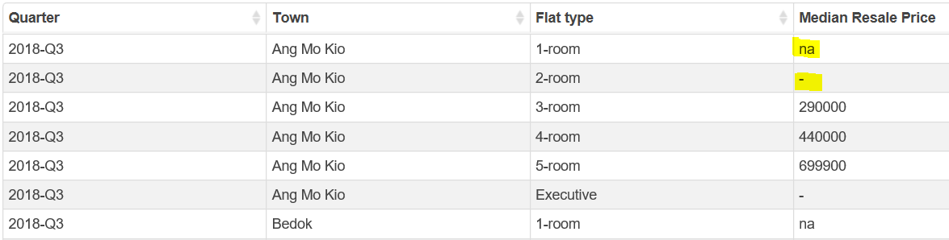
Median Resale Prices for Registered Applications Dataset
The data excluded transactions that may not accurately reflect the market price, i.e. resale of part shares, resale between related parties, cases under the Conversion Scheme, resale of terrace flats, converted flats, and HUDC flats.
The figures are rounded to the nearest hundred dollars. "na" indicates no resale transactions in this particular town and flat type. "-" refers to cases where there are less than 20 resale transactions in this particular town and flat type. Hence, median prices are not shown as they may not be representative.

Slide 12
Cooling Measures Dataset
cooldate | cooldatedesc | coolcolor
14/9/2009 | 14-Sep-09 | green
20/2/2010 | 20-Feb-10 | orange
30/8/2010 | 30-Aug-10 | cyan
14/1/2011 | 14-Jan-11 | magenta
8/12/2011 | 8-Dec-11 | yellowgreen
6/10/2012 | 6-Oct-12 | violet
12/1/2013 | 12-Jan-13 | turquoise
29/6/2013 | * 29 Jun 2013 | tomato
27/8/2013 | 27-Aug-13 | teal
11/3/2017 | 11-Mar-17 | sienna
6/7/2018 | 6-Jul-18 | lime
Custom made HDB Cooling Measures data to import it into CoolingMeasure.py
Data path: data\cooling-measure.csv
To get latest Cooling Measure date, either go to HDB web site or SRX web site. The URL as follow:
https://www.srx.com.sg/cooling-measures
For color selection, go to the following URL:
https://matplotlib.org/examples/color/named_colors.html

Slide 13
Cooling Measures Dataset
In order to further understand the HDB Cooling Measures affecting the HDB Resale Price, we could use the scatter plot graphical visualisation analysis.
We required x-axis as time line of HDB Cooling Measures and y-axis as the median HDB resale price.
Please note the x-axis is the time line. Therefore, we need to convert the quarter of Median Resale Prices Dataset into date and so is the Cooling Measure Date.
Since we required user to manually input the HDB Cooling Measures Date, I created a custom HDB Cooling CSV file so that user could update it.
Python Program: CoolingMeasure.py

Slide 14
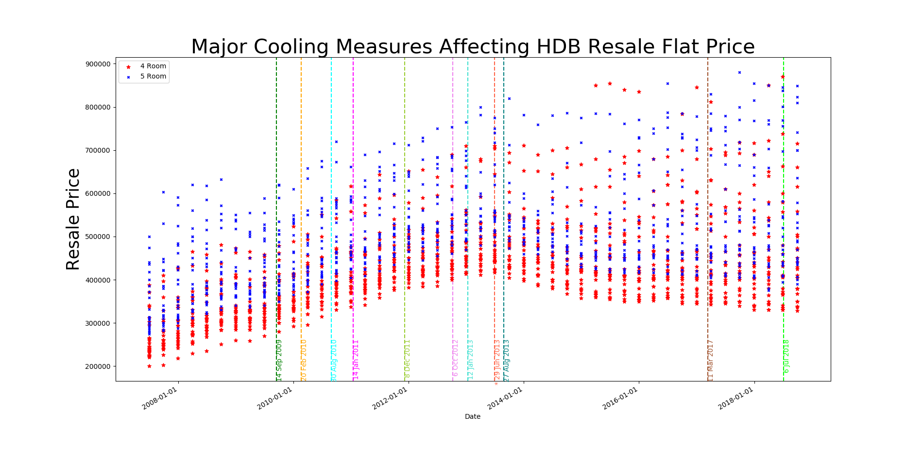
HDB Cooling Measures
You will notice some of the HDB cooling measures were not effective. The most effective cooling measures was implemented on 29 Jun 2013. The latest cooling measures was introduced on 6 Jul 2018.
Looking at the graph, not all price went down. We study this in the next graph.

Slide 15
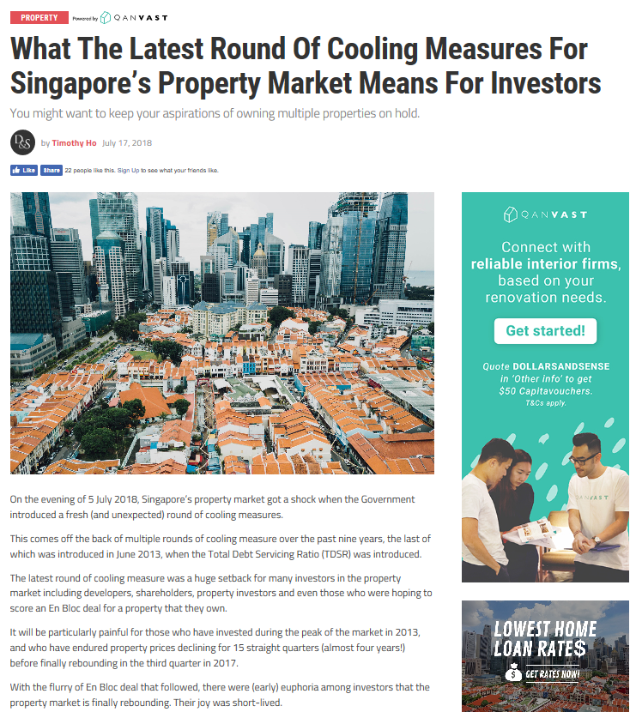
HDB Cooling Measures

Slide 16
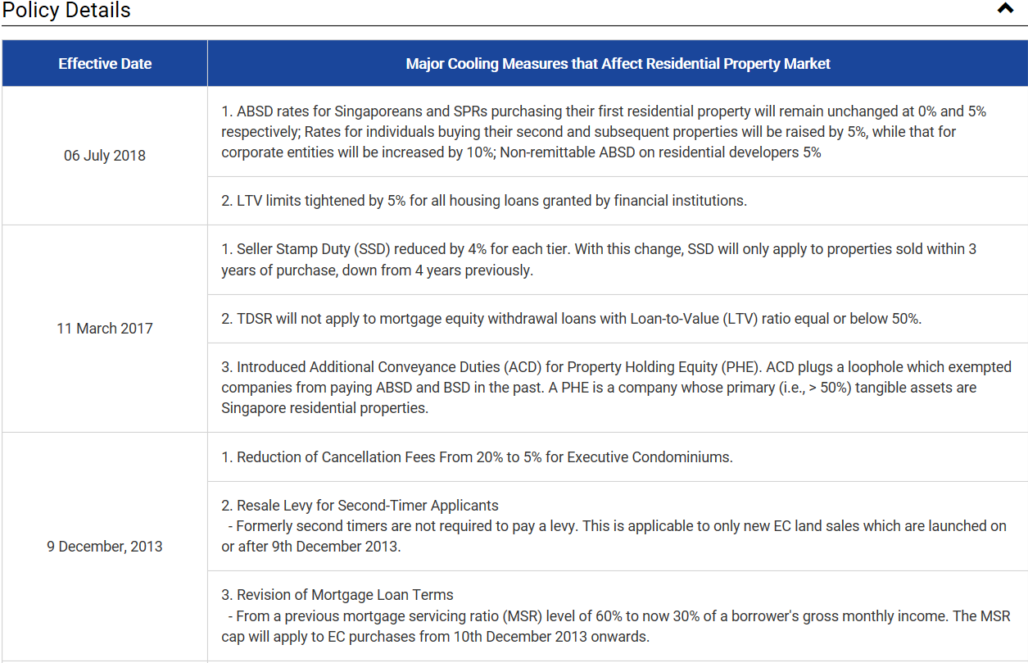
HDB Cooling Measures

Slide 17
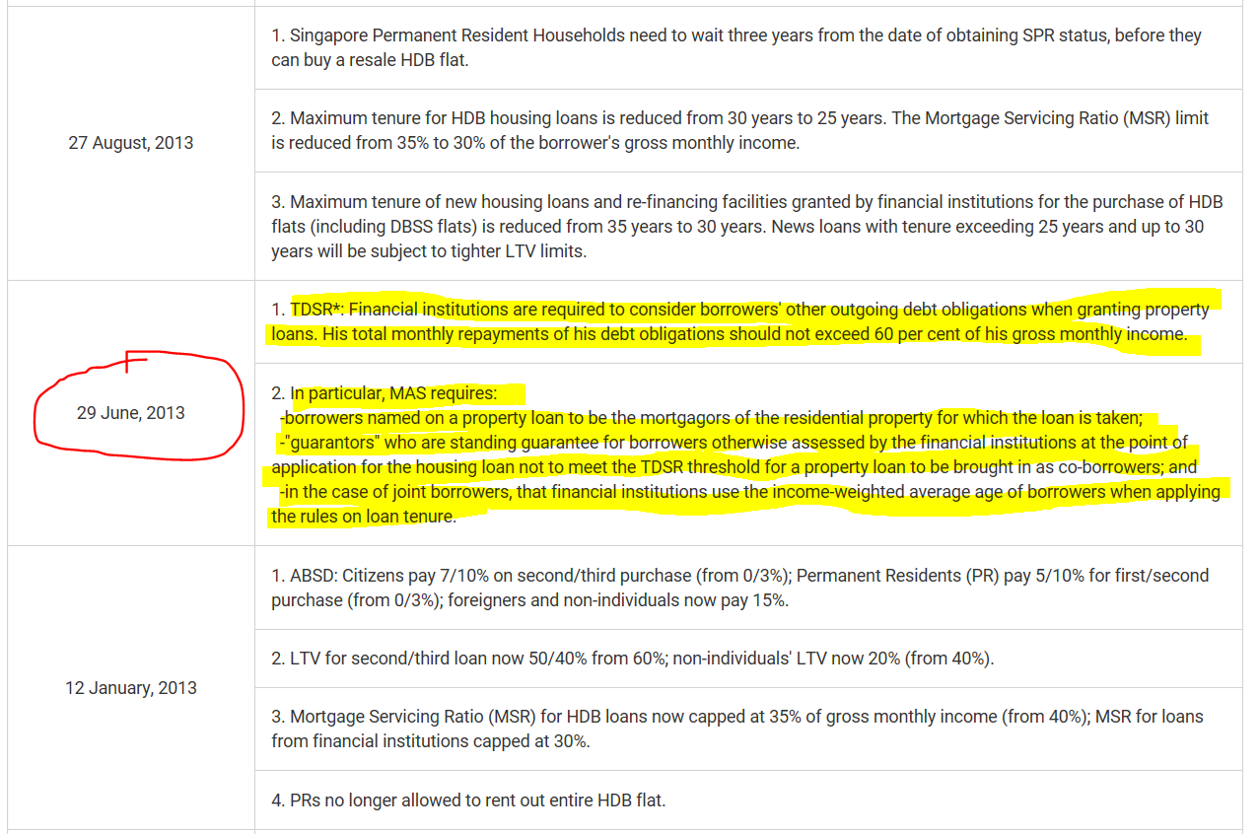
HDB Cooling Measures

Slide 18
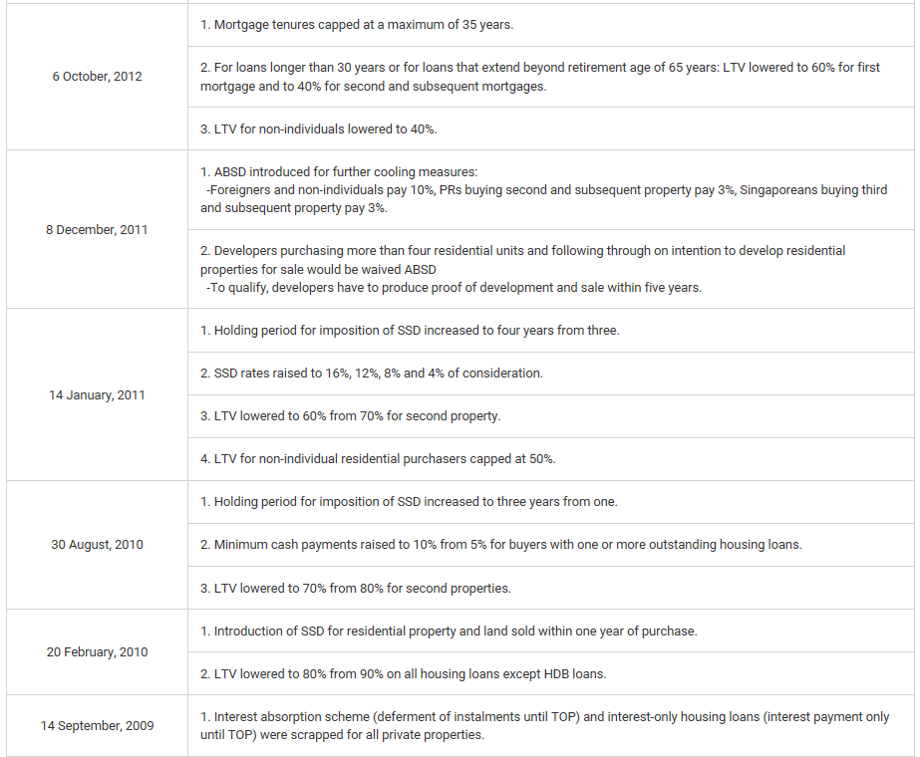
HDB Cooling Measures

Slide 19
Line Chart By HDB Town
Using the same HDB dataset as previous mentioned Cooling Measures, we could study whether each town deviation the same direction from each other.
Since we need to compare each town combination, I create a flexible selection of town using the matplotlib check buttons widgets and the variable colour list based on the number of town.
I also included the flat type as a selection criteria for user’s preference.
Python Program: LineChartByTown.py

Slide 20
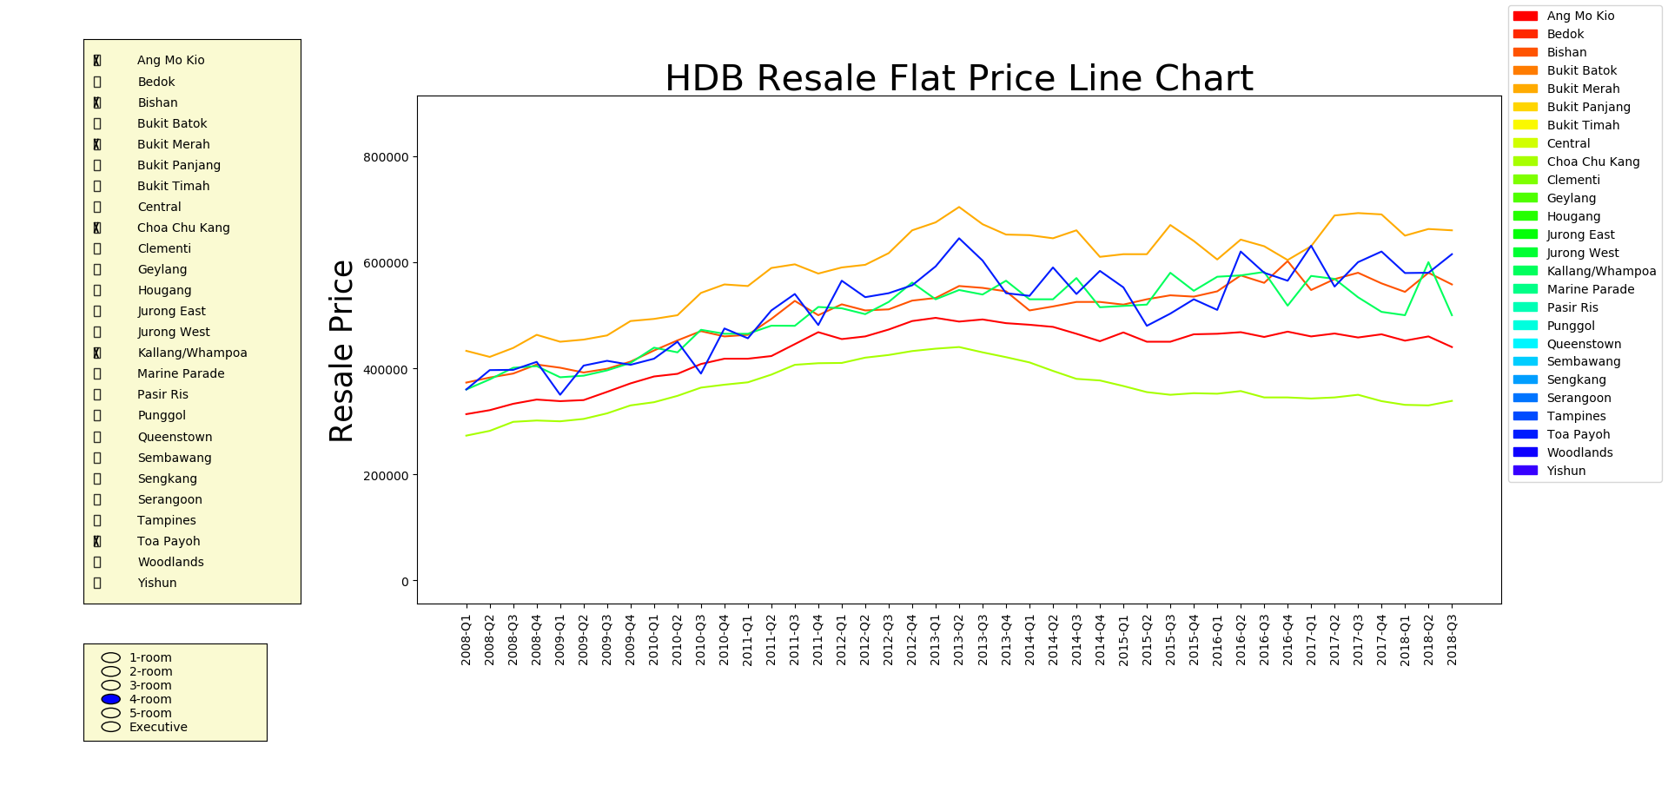
Line Chart By HDB Town
Based on the graph, the towns are fall into three categories:
High end tier such as Bishan, Toa Payoh, Bukit Merah, Kallang/Whampoa
Middle tier such as Ang Mo Kio
Lower tier site such as Choa Chu Kang
Majority HDB resale price fall in the middle and lower tier with some towns exceptionally high. We’ll look further when we look at next graph.

Slide 21
HDB Resale Flat Price
In order to study further on various town why there is a different resale price deviation, we need a flexible choice for user to choice and compare it.
The flexibility of selections also help user to select their preferences town and compare each town resale prices.
Therefore, we need the Resale Flat Prices Dataset data as it contains the details of resales flat.

Slide 22
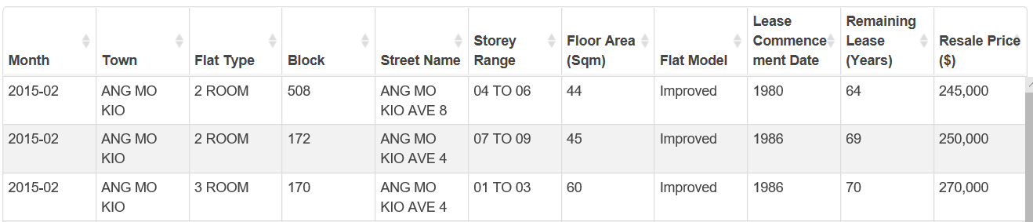
Resale Flat Prices Dataset
Resale transacted prices is based on date of registration for the resale transactions. The data is based January 2015 onward to the latest transaction date updated in HDB web site on 19 Dec 2018.
Notes:
The approximate floor area includes any recess area purchased, space adding item under HDB’s upgrading programmes, roof terrace, etc.
The transactions exclude resale transactions that may not reflect the full market price such as resale between relatives and resale of part shares.
Resale prices should be taken as indicative only as the resale prices agreed between buyers and sellers are dependent on many factors.
Remaining lease is the number of years left before the lease ends. This information is computed as at the resale flat application.

Slide 23
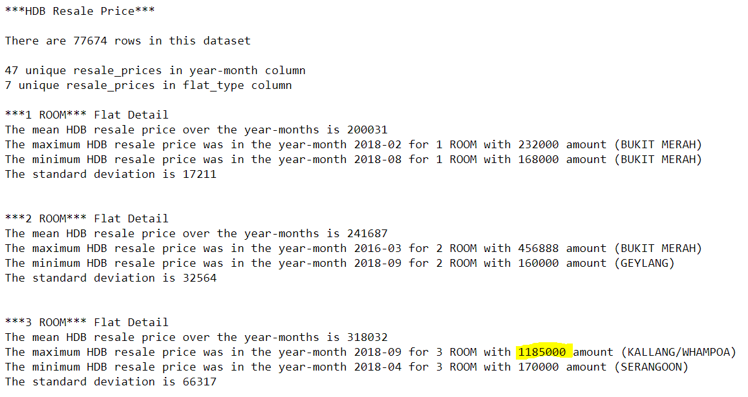
Resale Flat Prices Dataset

Slide 24
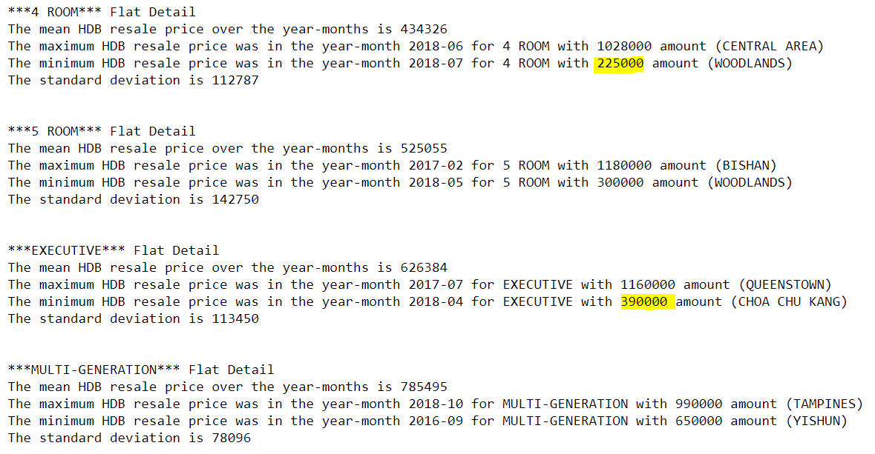
Resale Flat Prices Dataset

Slide 25
Resale Flat Prices
In order to cater for different user’s preferences, we need to allow user to select different choices based on the following:
Year of dataset
Town
Flat Type
Remaining Lease Year
To resolve above choices, we need to use interactive matplotlib widgets to help us.
Check button for Town selection, Radio Buttons for Flat Type as it is either choices and slider for Flat Type and Remaining Lease Year as it is year range.
Matplotlib Check button normally applied for line plot by setting visible or invisible. We need to workaround it for boxplot by setting the line plot x and y axis as zero. Then create a function to get the status of the line whether it is visible and applied it to the box plot graph.
We also need a text box interactive to show the detail when the mouse click on the graph
Python Program: ResaleFlat.py

Slide 26
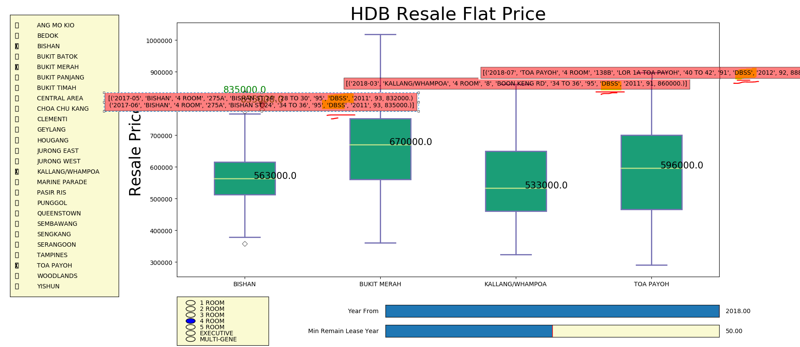
Resale Flat Prices
It seem that those higher prices are DBSS flat. But that does not suggest that the price deviation further is cause by this factor.

Slide 27
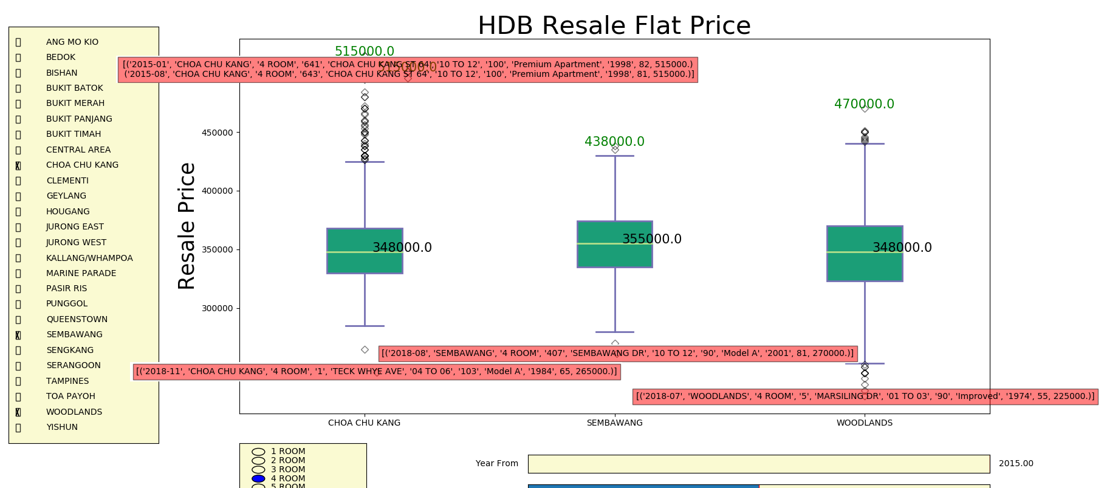
Resale Flat Prices
- The resales price has drop a lot for these town.
- The higher price are those premium apartment.

Slide 28
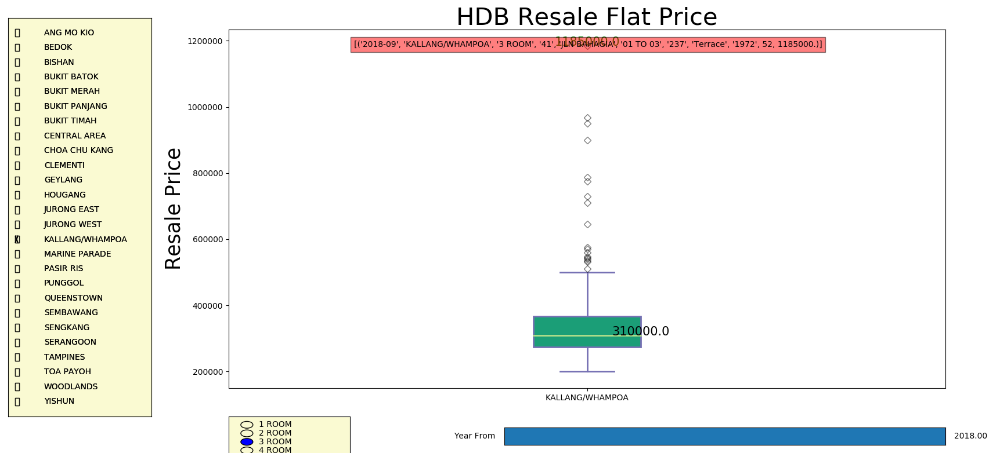
Exceptional Case
This 3-room flat is an exceptional case where the resale price is the highest in this dataset and it is even more expensive than 5 room or Executive or Multi-Gene.

Slide 29
Resale Flat Prices
Prices in all the towns generally at lined from the beginning of 2013. No surprise because of the cooling measures that hit the private property market. Few towns had price increases. For example Bishan, Bukit Merah, Clementi, Kallang/Whampoa, Toa Payoh and Queenstown. One common feature are that these towns are generally older/more mature, and are located closer to the city centre.
More towns saw at or declines in prices. For example Bukit Panjang, Choa Chu Kang, Jurong West, Pasir Ris, Sembawang, Sengkang and Woodlands had prices which decreased quite a fair bit. Reflecting from the above mentioned town, locations of these towns are generally further from the city centre.

Slide 30
Specific Flat History
After buyer has decided to purchase his desired flat or the seller wanted to know what is the suitable price to offer. He/she will want to know the history of the specific flat price range so that he could use it to negotiate with the buyer/seller.
We could use the same dataset as previous graph and bar chart will be suitable to full fill this requirement.
However, we need user interactive to input data:
Street Name
Floor number
Select the flat type
Based on the user input, get the average flat price by month and year.

Slide 31
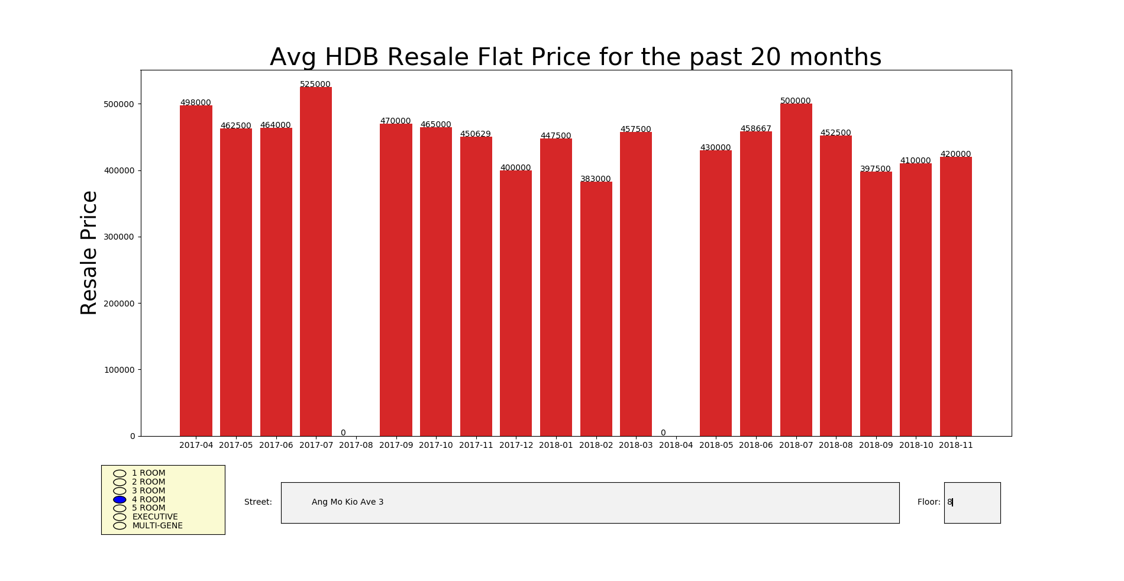
Specific Flat History
Currently, I set it to use the latest 20 months as too old data may not be adequate for this case.

Slide 32
Volume of Resale Flat
So far the graph show the resale flat price is either high or low but it does not show whether the volume of the resale flat application.
In order to resolve this issue, we will need to use the Number of HDB Resale Applications Dataset

Slide 33
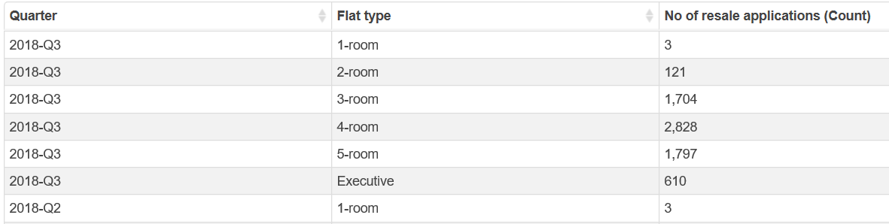
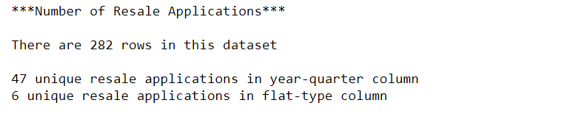
Number of Resale Applications Dataset
Number of Resale Applications Registered by Flat Type, by Quarter
It is best use to check the transaction volume during that period of time

Slide 34
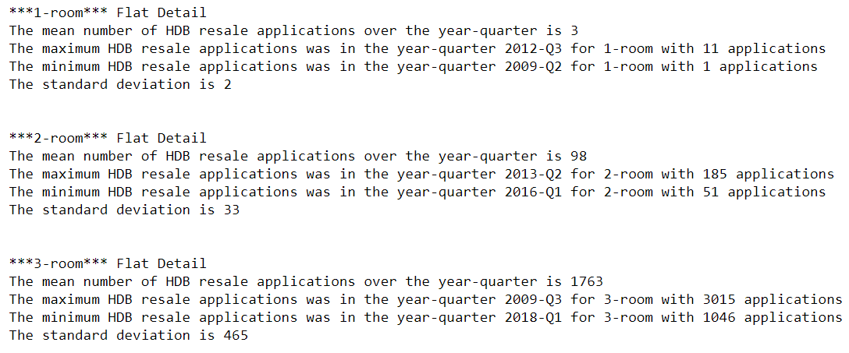
Number of Resale Applications Dataset

Slide 35
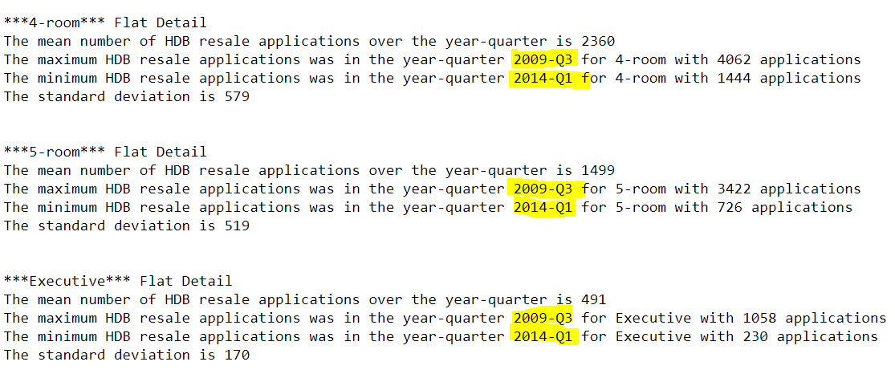
Number of Resale Applications Dataset

Slide 36
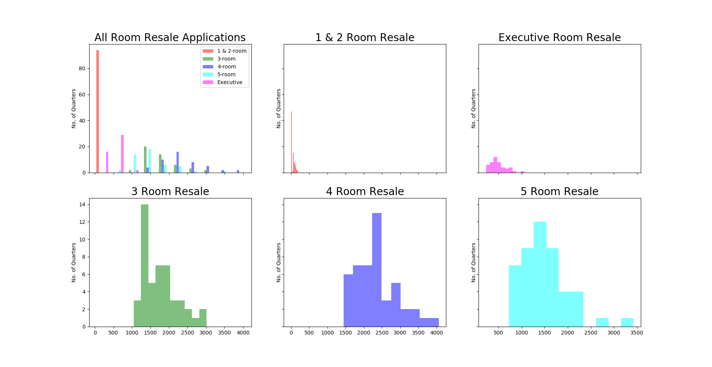
Volume of Resale Flat

Slide 37
Volume of Resale Flat
To show the volume of different flat type, I will use the histogram to illustrate it.
Notice that the 3 to 5 Room have higher volume as compare to 1-2 room and executive room. 1-2 room flat are limited as the executive room price are quite high.
Python Program: ResaleApplication.py

Slide 38
Additional Information
There is a ethnic quota within blocks of HDB flat. This is to ensure that the races are equally spread within town.
That means majority Chinese cannot buy flat from the minority ethnic group.
What is the percentage of these group ?
I’ll use the Resident HDB Households Dataset to help me derive the result.
Python Program: HDBdwelling.py

Slide 39
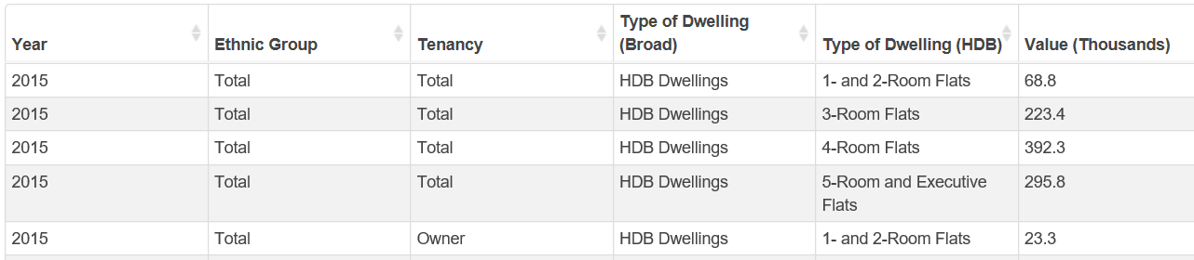
Resident HDB Households Dataset
From 1995, the General Household Survey (GHS) is conducted in between 2 Population Censuses as a mid-decade mini-Census.
The General Household Survey (GHS) 2015 is the third in the series of mid-decade national survey. It covers a wide range of topics and provides comprehensive data on Singapore’s population and households in between the population censuses that are conducted once in ten years.

Slide 40
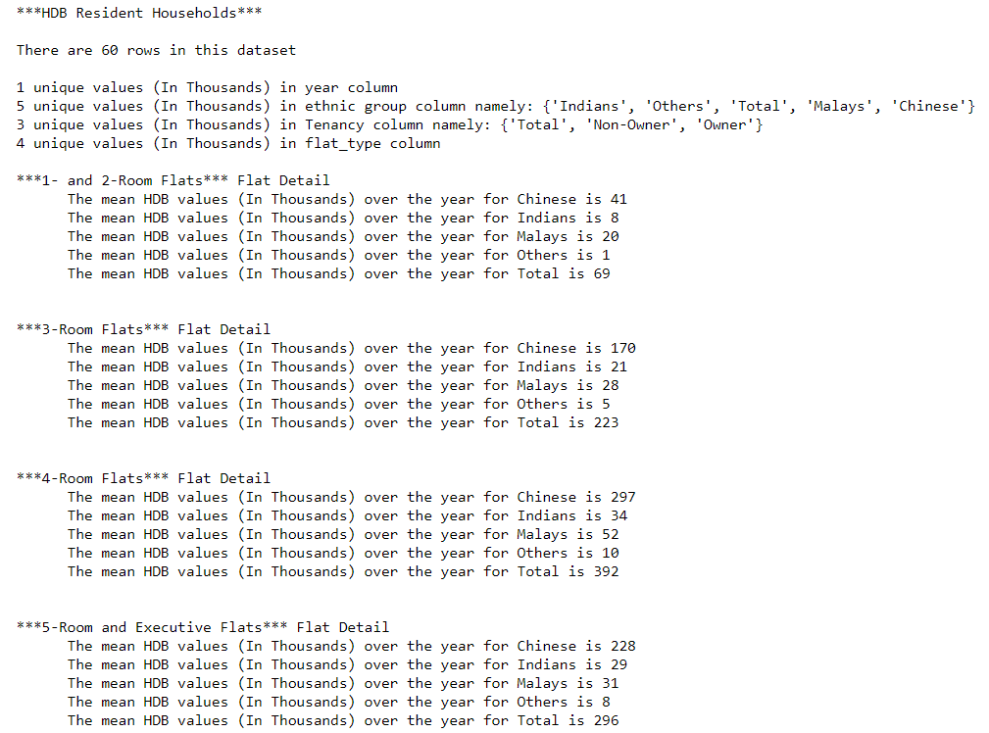
Resident HDB Households Dataset

Slide 41
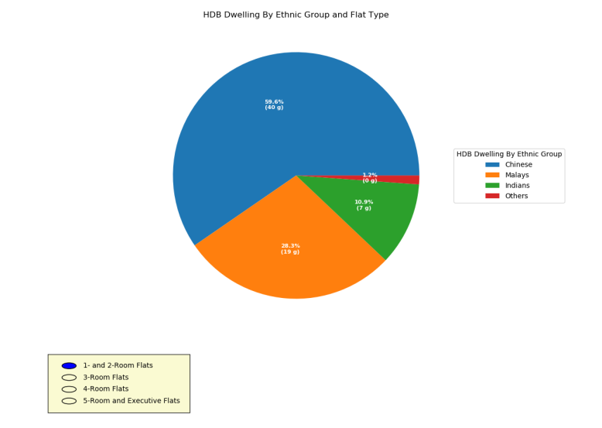
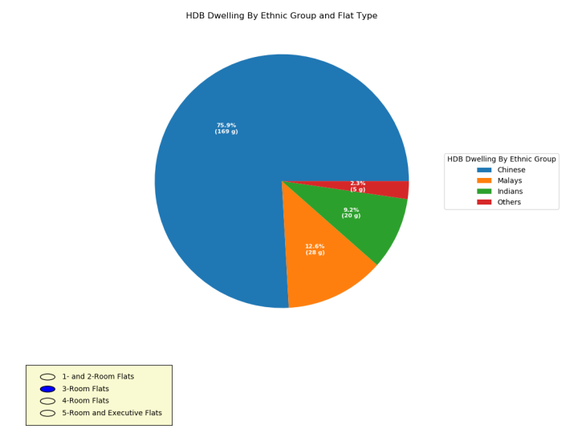
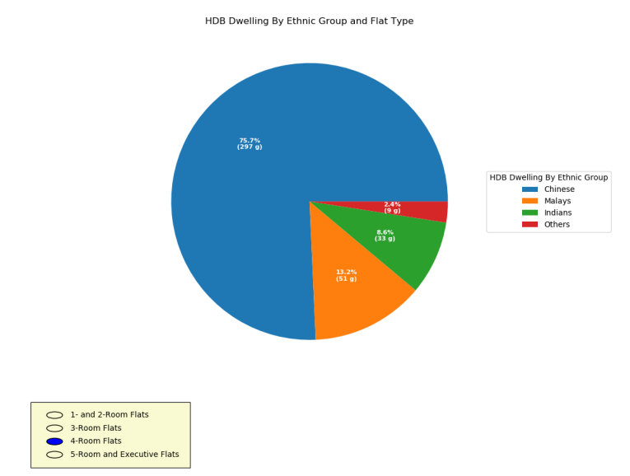
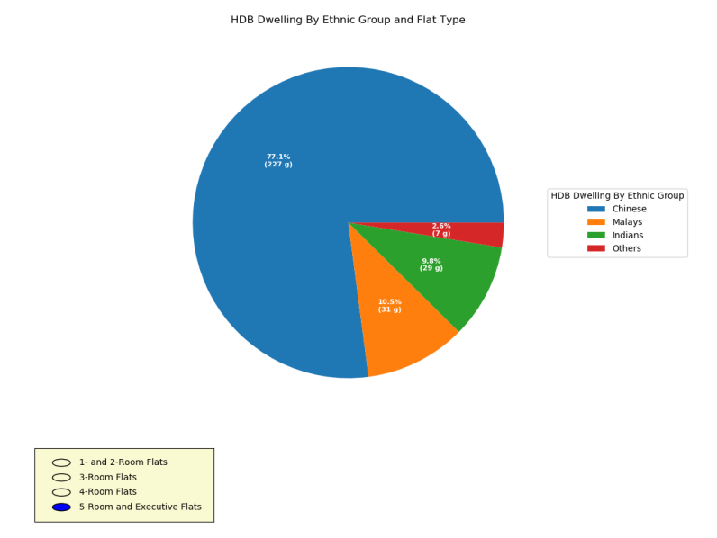
Resident HDB Households by ethnic group

Slide 42
Resident HDB Households by ethnic group
The 3 room, 4 room and 5 room percentage are quite close.
The 1 and 2 room have more Malay percentage as compare in 3 to 5 room.

Slide 43
Conclusion
If you are planning to upgrade or downgrade your flat, the price ratio are quite symmetrical if your flat tier are identical. As for the flat nearer to city will be more expensive as compare to the flat further away from the city.
It will not be advisable to plan for investment in HDB as an investment in mind as the cooling measures has taken place and you will ended up paying more taxes for owning more properties and more new flat will be roll in coming year 2019 which will affect the HDB resale prices.

